Slide 1
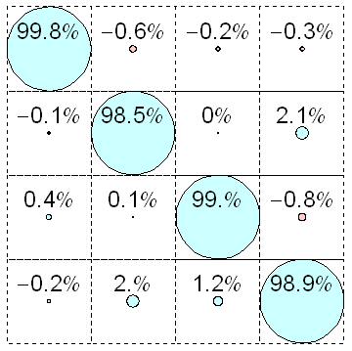
a)
b)
e) raw
R^{I}
R^{II}
10
01
00
11
c)
f) readout error
corrected
|1>
|0>
|1>
|0>
1
81%
81%
0
93%
88%
d)
|00>
|01>
|10>
|11>
I10>
00
g) crosstalk
corrected
01
I01>
10
I00>
11
I11>

Slide 2
1.0
II
IX
IY
IZ
XI
XX
XY
XZ
YI
YX
YY
YZ
ZI
ZX
ZY
ZZ
II
IX
IY
IZ
XI
XX
XY
XZ
YI
YX
YY
YZ
ZI
ZX
ZY
ZZ
II
IX
IY
IZ
XI
XX
XY
XZ
YI
YX
YY
YZ
ZI
ZX
ZY
ZZ
0.5
0.0
-
0.5
-
1.0
1.0
0.5
0.0
-
0.5
-
1.0
1.0
0.5
0.0
-
0.5
-
1.0
1.0
0.5
0.0
-
0.5
-
1.0
1.0
0.5
0.0
-
0.5
-
1.0
1.0
0.5
0.0
-
0.5
-
1.0

Slide 3
1.0
II
IX
IY
IZ
XI
XX
XY
XZ
YI
YX
YY
YZ
ZI
ZX
ZY
ZZ
II
IX
IY
IZ
XI
XX
XY
XZ
YI
YX
YY
YZ
ZI
ZX
ZY
ZZ
II
IX
IY
IZ
XI
XX
XY
XZ
YI
YX
YY
YZ
ZI
ZX
ZY
ZZ
0.5
0.0
-
0.5
-
1.0
1.0
0.5
0.0
-
0.5
-
1.0

